Slide 1

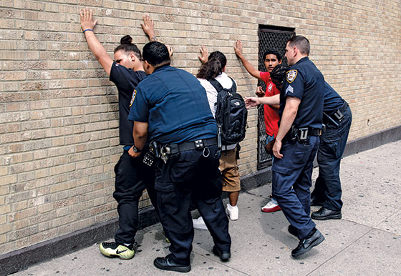

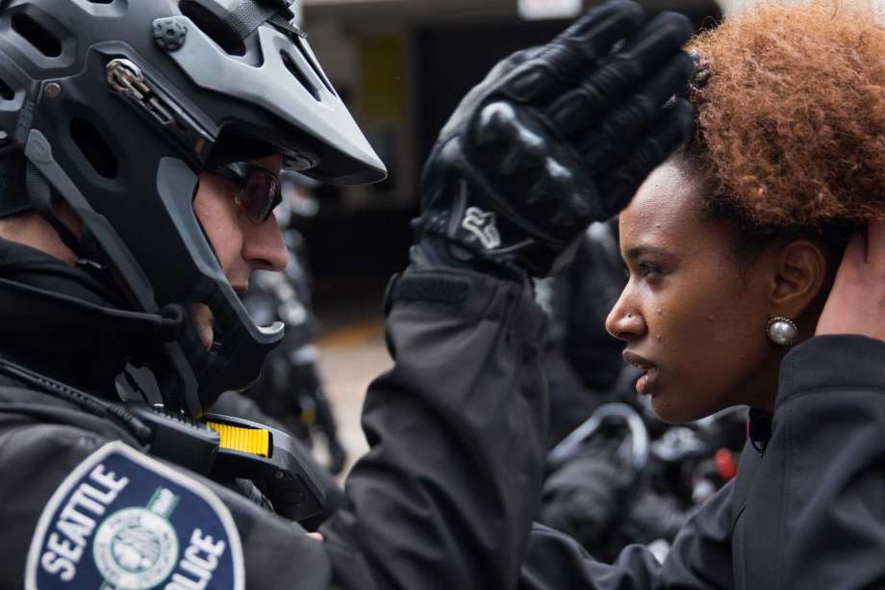
SEATTLE POLICE STOPS & detention analysis DATA MINING PRINCIPLES 31008
August 25, 2018
Jorge Argueta
Anthony Moliterno
Sherman Wallace

Slide 2
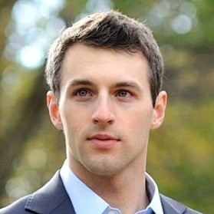
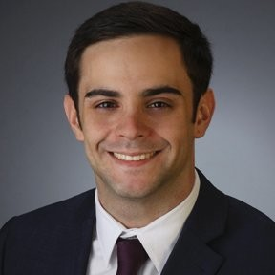
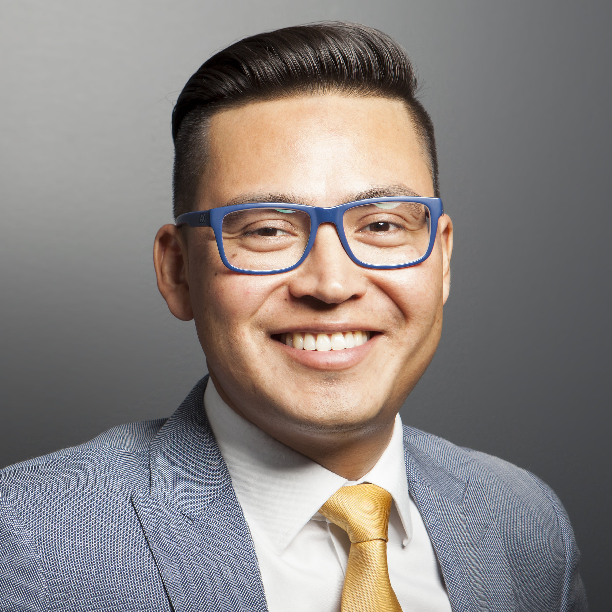
Our team
Sherman Wallace
Anthony Moliterno
Jorge Argueta

Slide 3
Agenda
Introduction
Why this data set?
Background – Policies & Overview
Dataset description
Exploratory Analysis
Inferential stats from PDF
Data cleaning
Data proportions
Modeling
LCA
Classification trees
Results

Slide 4
WHY THIS DATA SET?
We are curious to find a pattern or practice of bias by Seattle police officers in respect to Terry stops
Racial or age bias?
Is there transparency in this legal process?
The Seattle Police Department claims:
Officer use of force is an empirically rare event
When officers do use force, they do in a manner that is consistent in over 99% of the instances

Slide 5
BACKGROUND – Policies and Overview
This data represents records of police reported stops under Terry v. Ohio, 392 U.S. 1 (1968). Each row represents a unique stop.
A Terry stop is a seizure (restrained the liberty of a citizen) under both state and federal law. A Terry stop is defined in policy as a brief, minimally intrusive seizure of a subject based upon articulable reasonable suspicion in order to investigate possible criminal activity. The stop can apply to people as well as to vehicles. The subject of a Terry stop is not free to leave.
An officer may frisk, or pat-down, the subject of a Terry stop when, under the totality of the circumstances and reasonable conclusions drawn from the officer’s training and experience, the officer has reasonable suspicion that the subject may be armed and presently dangerous. A frisk is strictly limited to a search (generally a pat-down of outer clothing) necessary to the discovery of weapons that may be used to harm the officer or others nearby.

Slide 6
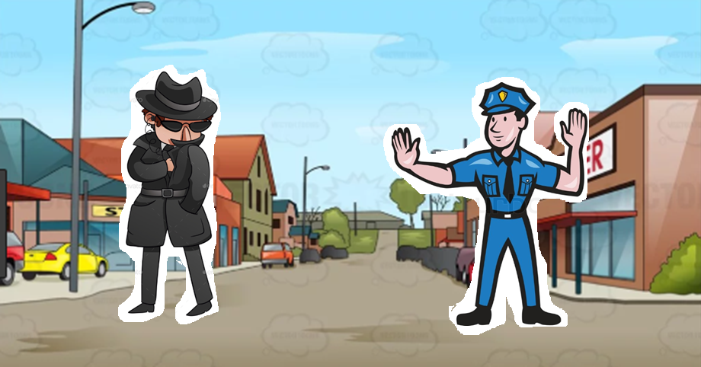
Terry v. Ohio
Notes:
Tell the story of Terry v Ohio: police officer stopped suspicious individuals and checked for gun and found a gun

Slide 7
Data set Content & context
Data from March 2015 to July 2018
Each record contains perceived demographics of the subject, as reported by the officer making the stop and officer demographics as reported to the Seattle Police Department.
Where available, data elements from the associated Computer Aided Dispatch (CAD) event (e.g. Call Type, Initial Call Type, Final Call Type) are included.
This is a dataset hosted by the City of Seattle. The city has an open data platform found here and they update their information according the amount of data that is brought in. Explore New York City using Kaggle and all of the data sources available through the City of Seattle organization page!
Officers are required to record at a minimum five pieces of information on the suspect, in conjunction with fielded and narrative data around Terry stops (on duty, date, time, location, duration).
Notes:
All categorical

Slide 8

Data set - Variables
Subject.Age.Group
Subject.ID
GO...SC.Num
Terry.Stop.ID
Stop.Resolution
Weapon.Type
Officer.ID
Officer.YOB
Officer.Gender
Officer.Race
Subject.Perceived.Race
Subject.Perceived.Gender
Reported.Date
Reported.Time
Initial.Call.Type
Final.Call.Type
Call.Type
Officer.Squad
Arrest.Flag
Frisk.Flag
Precinct
Sector
Beat
Final.call.urgency
Final.call.severity
Blue font = Categorical

Slide 9
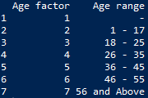
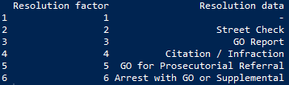
Data – Factors & levels

Slide 10
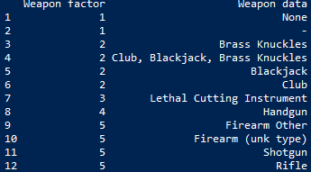
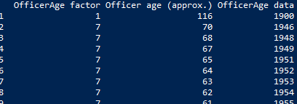
Data – Factors & levels

Slide 11
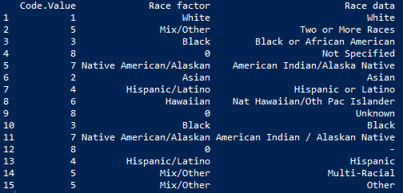
Data – Factors & levels

Slide 12
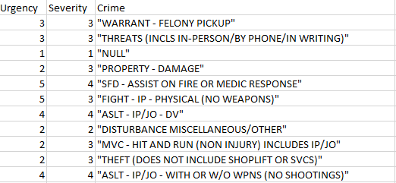
Data – Factors & levels

Slide 13
Data – Factors & levels
Very High
Strong Arm Robbery, Assault shot, Heard shot, Rape, Carjacking, Bank Alarm, Fight w/Weapons, Kidnapping, Assaults Gang Related, etc
High
Assist on fire/medic response, Assault (no shooting), Silent Alarm, Fight (no weapons), Arson, Road Rage, Purse Snatch, DUI, Abandoned Child, Residential Alarm, Bomb Threats, Missing Child, Officer Backup Needed, Explosion,
Medium
Suspicious Person, Shoplift, Harassment, Juvenile Runaway, Fraud, Narcotics, Verbal Fight, Eluding Police (foot), Liquor Violation, Escaped Prisoner, Reckless Burning, Property Damage, Injured Person, Sick Person, Disturbance (fight), etc
Low
Trespass, Traffic Stop, Lewd (flashing, urination), Mischief, Narcotics Found, Fireworks, Request to Watch, Overdose, Prostitution, Animal bite, Illegal Dumping, Bicycle Theft, Suspicious Circumstance, Person Runaway
Very Low
Onview Initiated-Premise Check, Follow up, Sex in Public Place, Panhandling, Welfare Check, Property Found, Noise, Parks Violation, Person Found, Sleeper Aboard on Train.

Slide 14
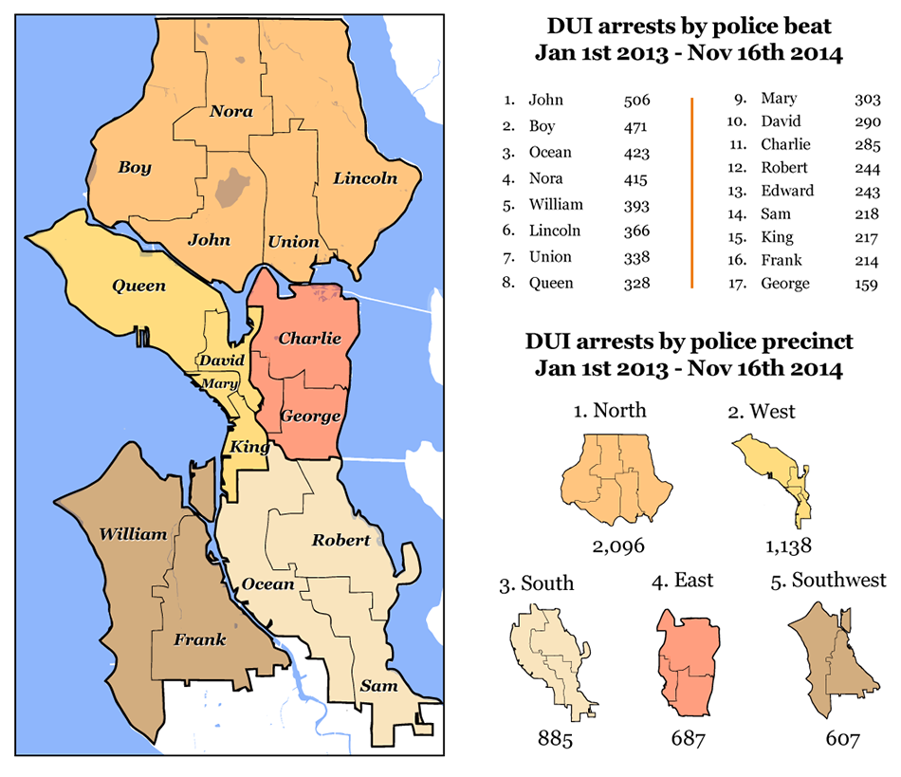
Seattle demographics
The racial composition of the city in 2016 was …
65.7% White,
14.1% Asian,
7.0% Black,
6.6% Hispanic/Latino,
0.4% Native American,
0.9% Pacific Islander,
2.3% other ethnicities,
and 5.6% from two or more ethnicities."

Slide 15
Basic Statistics – irregularities in proportionality
Seattle:
70% White
8% Black
Police Force:
78% White
4%
Subject:
49% White
31% Black
Frisk?
41% White
38% Black
Arrest?
45% White
33% Black
Notes:
We focused on Black and White because those were the most disproportional races in the statistics
Blacks were increasingly represented in incidents, and frisks, but slightly less to be arrested. Is there bias? We continue to look…

Slide 16
Terminology – Stop resolution outcomes
Low severity
Street Check: Contact with a community member that does not necessarily involve a violation of law or the identification of a crime.
GO Report: A General Offense report (GO Report) is documentation of suspicious activity that may form the basis for an arrest or help with an investigation.
Citation / Infraction: A citation for some violation or infringement of the law.
GO for Prosecutorial Referral: A General Offense report (GO Report) of a potential crime or investigation, with referral for prosecution.
Arrest with GO or Supplemental: An arrest, which by default necessitates a GO report and/or supplemental reports
Incidence of Resolution Outcomes:
- | 1%
Street Check | 37%
GO Report | 37%
Citation / Infraction | 0%
GO for Prosecutorial Referral | 2%
Arrest with GO or Supplemental | 22%
Total | 100%
High severity

Slide 17
MODELING

Slide 18
Latent class analysis
Helps us identify hidden population subgroups
Subgroups are unique from each other, but individuals within each other are similar
We are interested in identify sub groups within SPD dataset on Terry stops
Questions:
Is there a racial bias towards Terry stops?
Is there a racial bias towards arrests?
What is the relationship between various factors and stop resolution outcome?
We’ll get different groups and their marginal probabilities

Slide 19
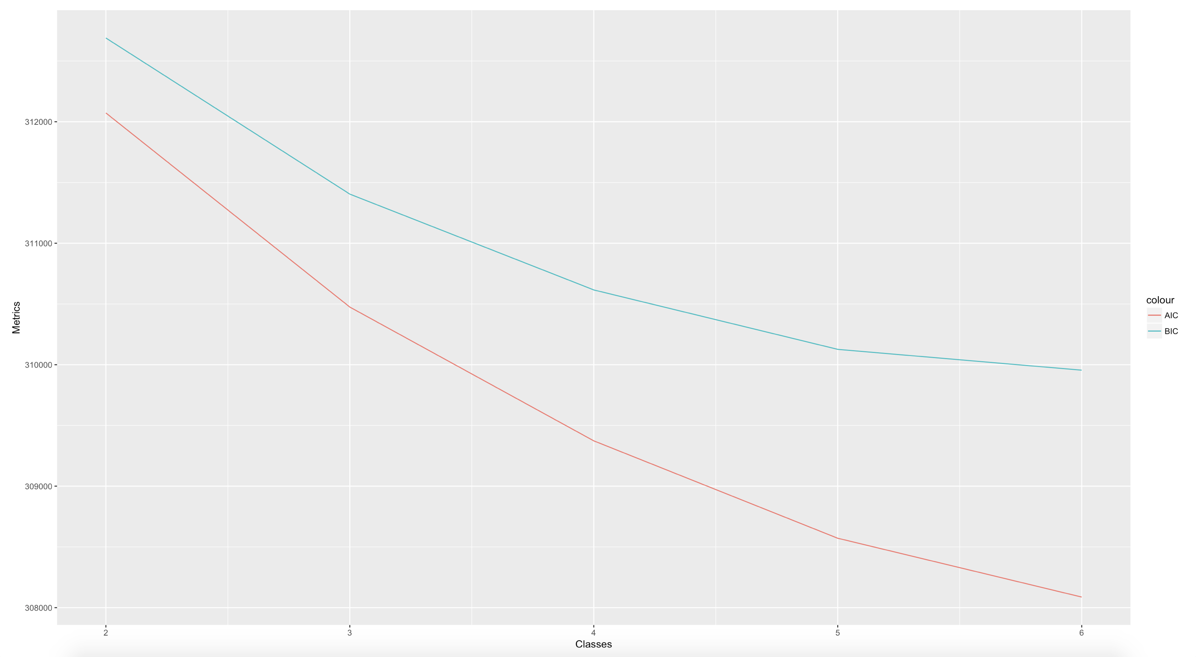
Latent class analysis – Scree Plot
AIC and BIC instructed optimal # of classes

Slide 20
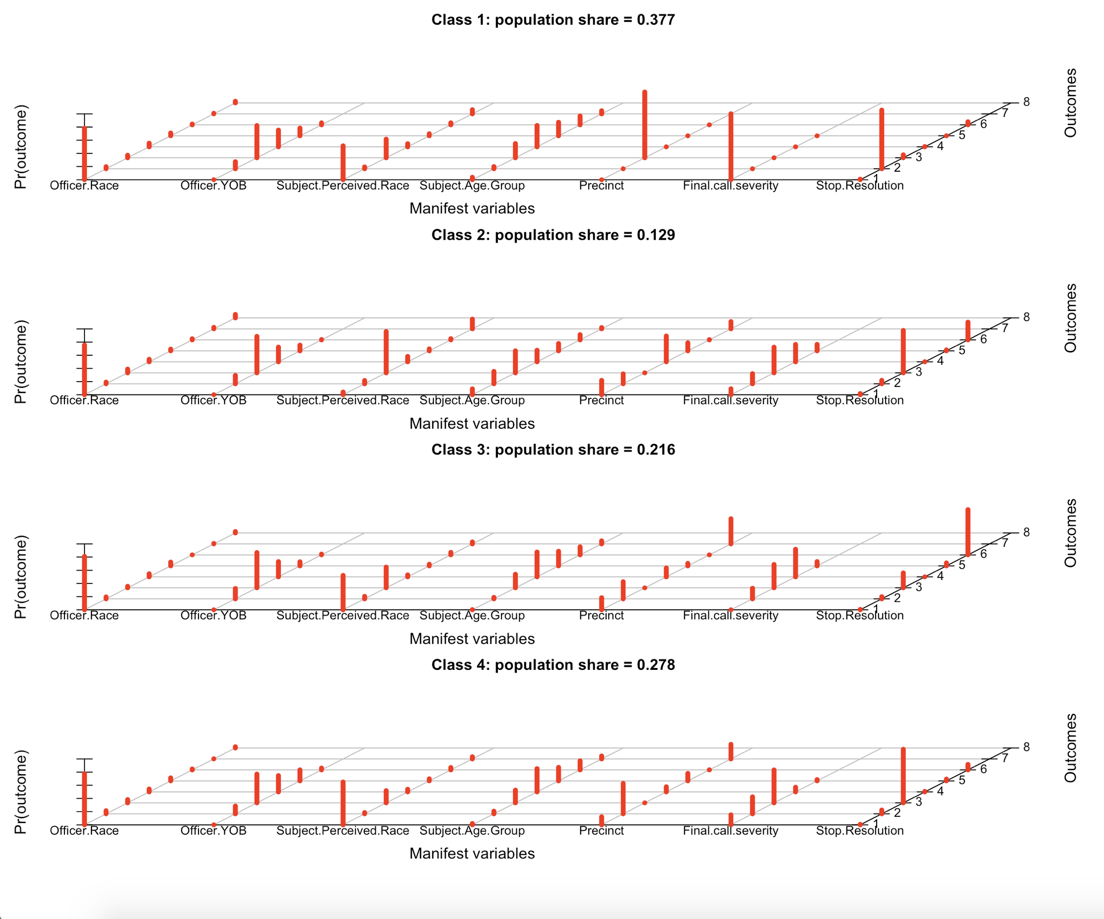
Officer.Race
Officer.YOB
Subject.Perceived.Race
Subject.Age.Group
Precinct
Final.call.severity
Stop.Resolution
Notes:
Animation – see slideshow.

Slide 21
Latent class analysis – Summary of each class
Class 1:
The largest class (37%). Lowest probability on call severity (oftentimes, no information on the incident); it makes sense that the stop resolution was mainly Street Check.
Leads to a follow up question: Why weren’t the officers recording the location of the event?
Class 2:
The smallest class (12%). Greatest probability of being young (ages 18-25), located in the South side of Seattle and subject perceived race African American. Final call severity included crimes such as warrants, threats, property damage, fights, theft and motor vehicle hit & run.
The stop resolutions with the highest probabilities were GO Report, followed by Arrest.
Class 3:
Highest probability of West side Precinct, highest probability on severity of all classes. Highest rate of arrests.
Both classes 3 & 4 shared the similarities in Subject Race and Age
Class 4:
Highest probability on the North side Precinct, high severity (but not as high as class 3). Tended to receive GO Reports.
Notes:
3&4 - Both classes share the same similarities in Subject Race and Age, but the Stop Resolution was totally different depending on the location and severity of the incident reported over the phone. If you were in the West Side the subjects had the highest probability of getting arrested on crimes with severity of level 4; on the contrary if you were on the North Side of Seattle, the subjects had the highest probability of only getting a General Offense report even when the severity of the call was higher than on the West Side.

Slide 22
Comparison between classes 3 & 4:
Precinct
Stop Resolution
Officer.Race
Officer.YOB
Subject.Perceived.Race
Subject.Age.Group
Precinct
Final.call.severity
Stop.Resolution
Notes:
Animation – see slideshow.

Slide 23
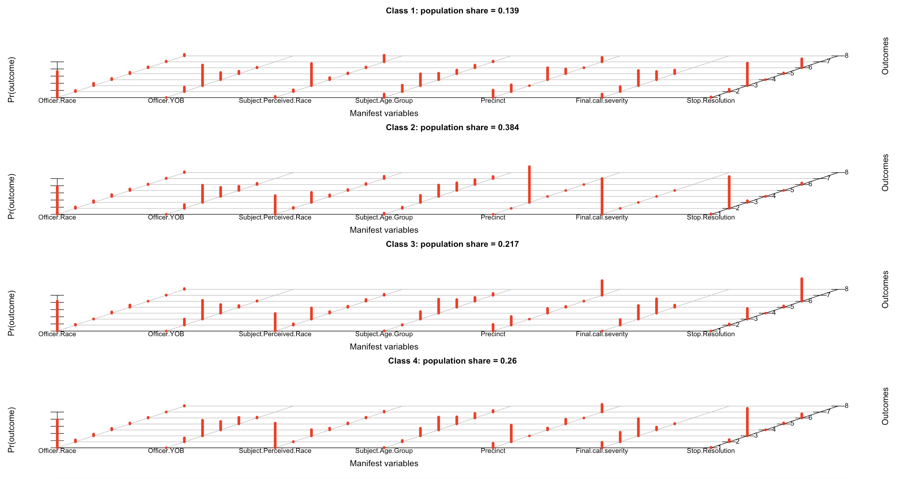
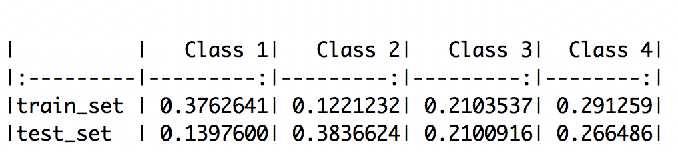
Holdout results & Proportions
Even when the class size proportions are not identical, they are close to each other.
This model is stable.

Slide 24
Classification Trees
3 events were explored:
What led to stop resolution outcome (6 possible outcomes)?
What led to being frisked?
What led to getting arrested?

Slide 25
Classification Tree: Stop resolution outcome
Variables Used:
Stop.Resolution ← dependent variable
Call.Type
Final.call.urgency
Final.call.severity
Weapon.Type
Subject.Age.Group
Subject.Perceived.Race
Subject.Perceived.Gender
Officer.YOB
Officer.Gender
Officer.Race
Precinct
Possible Resolution Outcomes: (Stop.Resolution)
- | 1%
Street Check | 37%
GO Report | 37%
Citation / Infraction | 0%
GO for Prosecutorial Referral | 2%
Arrest with GO or Supplemental | 22%
Total | 100%
(Ranked by severity)

Slide 26
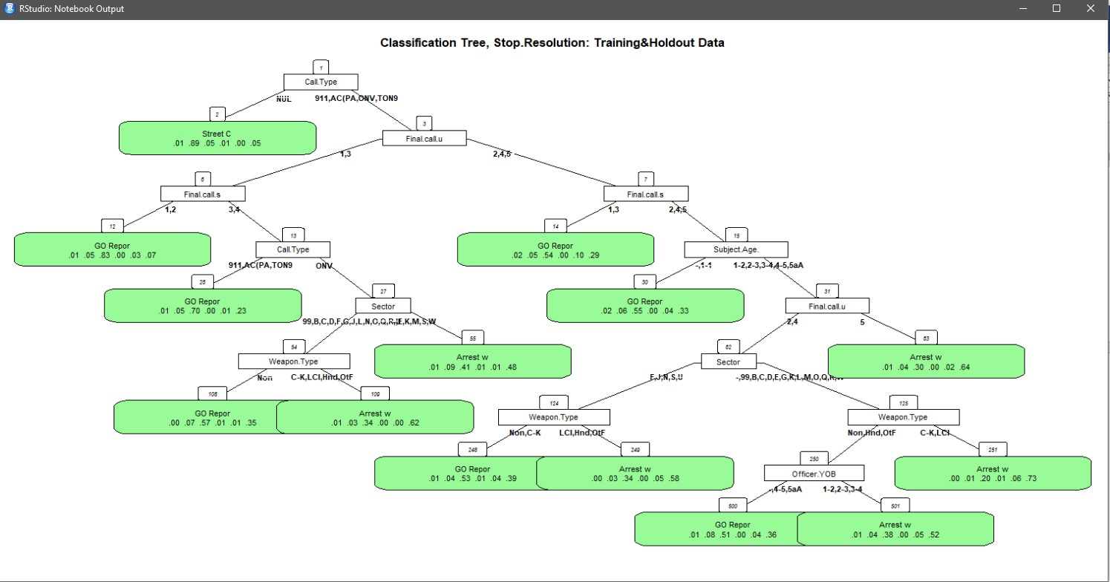
Stop Resolution Outcome

Slide 27
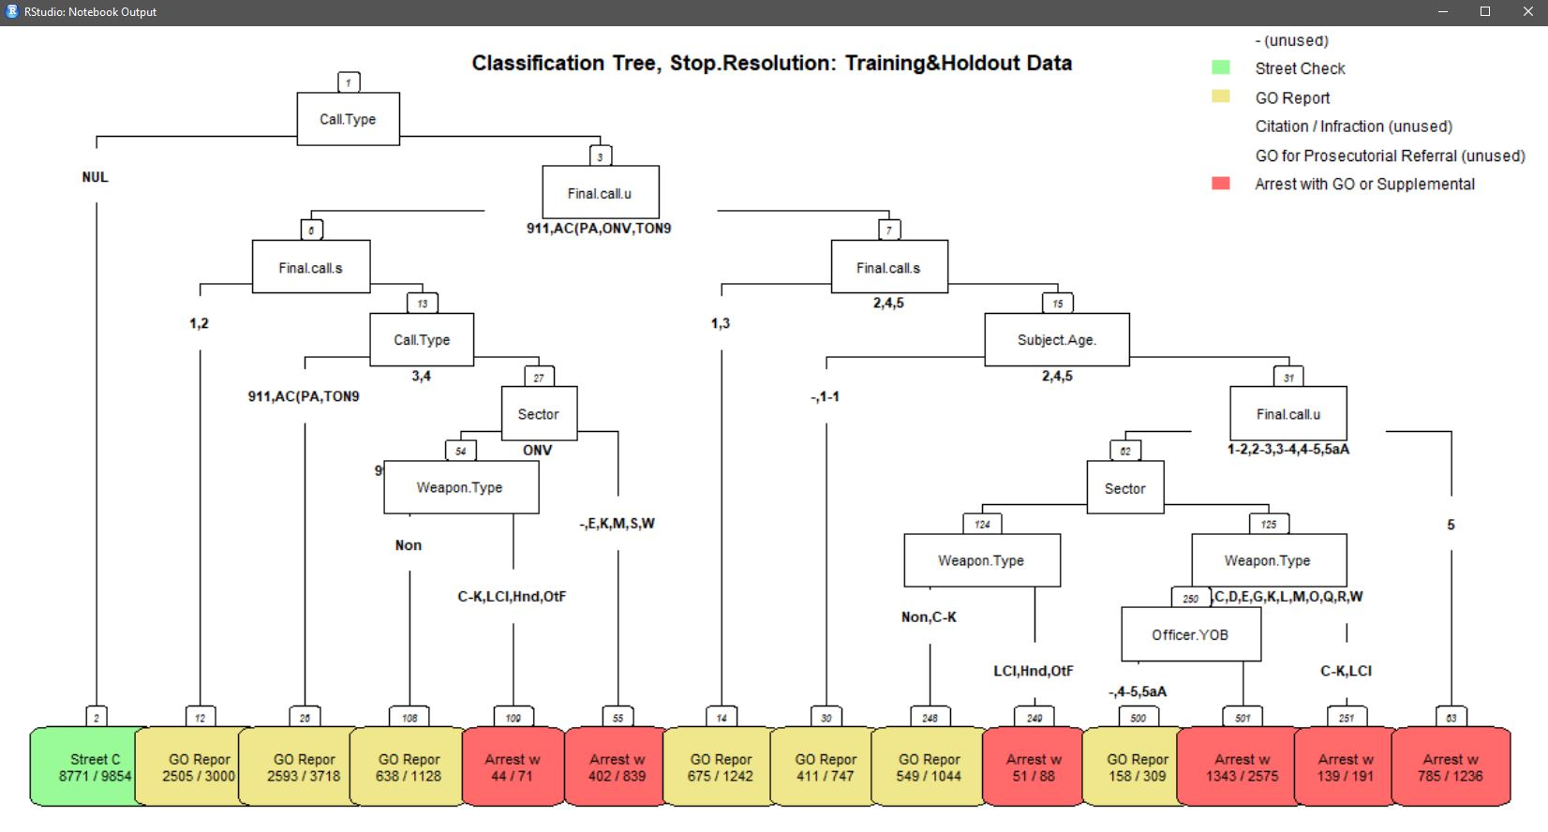
Stop Resolution Outcome

Slide 28
n= 26042 Legend: node), split, n, loss, yval, (yprob) * denotes terminal node Indentation level indicates level
Stop Resolution Outcome
1) root 26042 16292 GO Report (0.0098 0.37 0.37 0.0041 0.021 0.22)
2) Call.Type=NULL 9854 1083 Street Check (0.0099 0.89 0.045 0.0053 0.0026 0.047) *
3) Call.Type=911,ALARM CALL (NOT POLICE ALARM),ONVIEW,TELEPHONE OTHER, NOT 911 16188 6885 GO Report (0.0098 0.05 0.57 0.0035 0.031 0.33)
6) Final.call.urgency=1,3 8756 2654 GO Report (0.0082 0.055 0.7 0.0035 0.017 0.22)
12) Final.call.severity=1,2 3000 495 GO Report (0.01 0.048 0.83 0.0043 0.029 0.074) *
13) Final.call.severity=3,4 5756 2159 GO Report (0.0073 0.059 0.62 0.0031 0.012 0.29)
26) Call.Type=911,ALARM CALL (NOT POLICE ALARM),TELEPHONE OTHER, NOT 911 3718 1125 GO Report (0.0086 0.048 0.7 0.0016 0.014 0.23) *
27) Call.Type=ONVIEW 2038 1034 GO Report (0.0049 0.079 0.49 0.0059 0.0069 0.41)
54) Sector=99,B,C,D,F,G,J,L,N,O,Q,R,U 1199 537 GO Report (0.0033 0.068 0.55 0.0058 0.0075 0.36)
108) Weapon.Type=None 1128 490 GO Report (0.0027 0.071 0.57 0.0062 0.008 0.35) *
109) Weapon.Type=Club-Knuckles-Blackjack,Lethal Cutting Instrument,Handgun,Other Firearm 71 27 Arrest with GO or Supplemental (0.014 0.028 0.34 0 0 0.62) *
55) Sector=-,E,K,M,S,W 839 437 Arrest with GO or Supplemental (0.0072 0.094 0.41 0.006 0.006 0.48) *
7) Final.call.urgency=2,4,5 7432 3998 Arrest with GO or Supplemental (0.012 0.044 0.43 0.0034 0.048 0.46)
14) Final.call.severity=1,3 1242 567 GO Report (0.017 0.046 0.54 0.0048 0.099 0.29) *
15) Final.call.severity=2,4,5 6190 3116 Arrest with GO or Supplemental (0.011 0.044 0.41 0.0031 0.038 0.5)
30) Subject.Age.Group=-,1 - 17 747 336 GO Report (0.023 0.063 0.55 0.0013 0.037 0.33) *
31) Subject.Age.Group=18 - 25,26 - 35,36 - 45,46 - 55,56 and Above 5443 2612 Arrest with GO or Supplemental (0.0088 0.042 0.39 0.0033 0.038 0.52)
62) Final.call.urgency=2,4 4207 2161 Arrest with GO or Supplemental (0.0088 0.043 0.41 0.0043 0.044 0.49)
124) Sector=F,J,N,S,U 1132 553 GO Report (0.0071 0.037 0.51 0.0062 0.038 0.4)
248) Weapon.Type=None,Club-Knuckles-Blackjack 1044 495 GO Report (0.0077 0.037 0.53 0.0067 0.037 0.39) *
249) Weapon.Type=Lethal Cutting Instrument,Handgun,Other Firearm 88 37 Arrest with GO or Supplemental (0 0.034 0.34 0 0.045 0.58) *
125) Sector=-,99,B,C,D,E,G,K,L,M,O,Q,R,W 3075 1482 Arrest with GO or Supplemental (0.0094 0.045 0.38 0.0036 0.046 0.52)
250) Weapon.Type=None,Handgun,Other Firearm 2884 1430 Arrest with GO or Supplemental (0.01 0.048 0.39 0.0035 0.045 0.5)
500) Officer.YOB=-,46 - 55,56 and Above 309 151 GO Report (0.0065 0.081 0.51 0.0032 0.039 0.36) *
501) Officer.YOB=18 - 25,26 - 35,36 - 45 2575 1232 Arrest with GO or Supplemental (0.01 0.043 0.38 0.0035 0.046 0.52) *
251) Weapon.Type=Club-Knuckles-Blackjack,Lethal Cutting Instrument 191 52 Arrest with GO or Supplemental (0 0.0052 0.2 0.0052 0.058 0.73) *
63) Final.call.urgency=5 1236 451 Arrest with GO or Supplemental (0.0089 0.037 0.3 0 0.017 0.64) *

Slide 29
n= 26042 Legend: node), split, n, loss, yval, (yprob) * denotes terminal node Indentation level indicates level
Stop Resolution Outcome
1) root 26042 16292 GO Report (0.0098 0.37 0.37 0.0041 0.021 0.22)
2) Call.Type=NULL 9854 1083 Street Check (0.0099 0.89 0.045 0.0053 0.0026 0.047) *
3) Call.Type=911,ALARM CALL (NOT POLICE ALARM),ONVIEW,TELEPHONE OTHER, NOT 911 16188 6885 GO Report (0.0098 0.05 0.57 0.0035 0.031 0.33)
6) Final.call.urgency=1,3 8756 2654 GO Report (0.0082 0.055 0.7 0.0035 0.017 0.22)
12) Final.call.severity=1,2 3000 495 GO Report (0.01 0.048 0.83 0.0043 0.029 0.074) *
13) Final.call.severity=3,4 5756 2159 GO Report (0.0073 0.059 0.62 0.0031 0.012 0.29)
26) Call.Type=911,ALARM CALL (NOT POLICE ALARM),TELEPHONE OTHER, NOT 911 3718 1125 GO Report (0.0086 0.048 0.7 0.0016 0.014 0.23) *
27) Call.Type=ONVIEW 2038 1034 GO Report (0.0049 0.079 0.49 0.0059 0.0069 0.41)
54) Sector=99,B,C,D,F,G,J,L,N,O,Q,R,U 1199 537 GO Report (0.0033 0.068 0.55 0.0058 0.0075 0.36)
108) Weapon.Type=None 1128 490 GO Report (0.0027 0.071 0.57 0.0062 0.008 0.35) *
109) Weapon.Type=Club-Knuckles-Blackjack,Lethal Cutting Instrument,Handgun,Other Firearm 71 27 Arrest with GO or Supplemental (0.014 0.028 0.34 0 0 0.62) *
55) Sector=-,E,K,M,S,W 839 437 Arrest with GO or Supplemental (0.0072 0.094 0.41 0.006 0.006 0.48) *
7) Final.call.urgency=2,4,5 7432 3998 Arrest with GO or Supplemental (0.012 0.044 0.43 0.0034 0.048 0.46)
14) Final.call.severity=1,3 1242 567 GO Report (0.017 0.046 0.54 0.0048 0.099 0.29) *
15) Final.call.severity=2,4,5 6190 3116 Arrest with GO or Supplemental (0.011 0.044 0.41 0.0031 0.038 0.5)
30) Subject.Age.Group=-,1 - 17 747 336 GO Report (0.023 0.063 0.55 0.0013 0.037 0.33) *
31) Subject.Age.Group=18 - 25,26 - 35,36 - 45,46 - 55,56 and Above 5443 2612 Arrest with GO or Supplemental (0.0088 0.042 0.39 0.0033 0.038 0.52)
62) Final.call.urgency=2,4 4207 2161 Arrest with GO or Supplemental (0.0088 0.043 0.41 0.0043 0.044 0.49)
124) Sector=F,J,N,S,U 1132 553 GO Report (0.0071 0.037 0.51 0.0062 0.038 0.4)
248) Weapon.Type=None,Club-Knuckles-Blackjack 1044 495 GO Report (0.0077 0.037 0.53 0.0067 0.037 0.39) *
249) Weapon.Type=Lethal Cutting Instrument,Handgun,Other Firearm 88 37 Arrest with GO or Supplemental (0 0.034 0.34 0 0.045 0.58) *
125) Sector=-,99,B,C,D,E,G,K,L,M,O,Q,R,W 3075 1482 Arrest with GO or Supplemental (0.0094 0.045 0.38 0.0036 0.046 0.52)
250) Weapon.Type=None,Handgun,Other Firearm 2884 1430 Arrest with GO or Supplemental (0.01 0.048 0.39 0.0035 0.045 0.5)
500) Officer.YOB=-,46 - 55,56 and Above 309 151 GO Report (0.0065 0.081 0.51 0.0032 0.039 0.36) *
501) Officer.YOB=18 - 25,26 - 35,36 - 45 2575 1232 Arrest with GO or Supplemental (0.01 0.043 0.38 0.0035 0.046 0.52) *
251) Weapon.Type=Club-Knuckles-Blackjack,Lethal Cutting Instrument 191 52 Arrest with GO or Supplemental (0 0.0052 0.2 0.0052 0.058 0.73) *
63) Final.call.urgency=5 1236 451 Arrest with GO or Supplemental (0.0089 0.037 0.3 0 0.017 0.64) *

Slide 30
n= 26042 Legend: node), split, n, loss, yval, (yprob) * denotes terminal node Indentation level indicates level
Stop Resolution Outcome
1) root 26042 16292 GO Report (0.0098 0.37 0.37 0.0041 0.021 0.22)
2) Call.Type=NULL 9854 1083 Street Check (0.0099 0.89 0.045 0.0053 0.0026 0.047) *
3) Call.Type=911,ALARM CALL (NOT POLICE ALARM),ONVIEW,TELEPHONE OTHER, NOT 911 16188 6885 GO Report (0.0098 0.05 0.57 0.0035 0.031 0.33)
6) Final.call.urgency=1,3 8756 2654 GO Report (0.0082 0.055 0.7 0.0035 0.017 0.22)
12) Final.call.severity=1,2 3000 495 GO Report (0.01 0.048 0.83 0.0043 0.029 0.074) *
13) Final.call.severity=3,4 5756 2159 GO Report (0.0073 0.059 0.62 0.0031 0.012 0.29)
26) Call.Type= 911,ALARM CALL (NOT POLICE ALARM),TELEPHONE OTHER, NOT 911 3718 1125 GO Report (0.0086 0.048 0.70 0.0016 0.014 0.23) *
27) Call.Type= ONVIEW 2038 1034 GO Report (0.0049 0.079 0.49 0.0059 0.0069 0.41)
54) Sector=99,B,C,D,F,G,J,L,N,O,Q,R,U 1199 537 GO Report (0.0033 0.068 0.55 0.0058 0.0075 0.36)
108) Weapon.Type=None 1128 490 GO Report (0.0027 0.071 0.57 0.0062 0.008 0.35) *
109) Weapon.Type=Club-Knuckles-Blackjack,Lethal Cutting Instrument,Handgun,Other Firearm 71 27 Arrest with GO or Supplemental (0.014 0.028 0.34 0 0 0.62) *
55) Sector=-,E,K,M,S,W 839 437 Arrest with GO or Supplemental (0.0072 0.094 0.41 0.006 0.006 0.48) *
7) Final.call.urgency=2,4,5 7432 3998 Arrest with GO or Supplemental (0.012 0.044 0.43 0.0034 0.048 0.46)
14) Final.call.severity=1,3 1242 567 GO Report (0.017 0.046 0.54 0.0048 0.099 0.29) *
15) Final.call.severity=2,4,5 6190 3116 Arrest with GO or Supplemental (0.011 0.044 0.41 0.0031 0.038 0.5)
30) Subject.Age.Group=-,1 - 17 747 336 GO Report (0.023 0.063 0.55 0.0013 0.037 0.33) *
31) Subject.Age.Group=18 - 25,26 - 35,36 - 45,46 - 55,56 and Above 5443 2612 Arrest with GO or Supplemental (0.0088 0.042 0.39 0.0033 0.038 0.52)
62) Final.call.urgency=2,4 4207 2161 Arrest with GO or Supplemental (0.0088 0.043 0.41 0.0043 0.044 0.49)
124) Sector=F,J,N,S,U 1132 553 GO Report (0.0071 0.037 0.51 0.0062 0.038 0.4)
248) Weapon.Type=None,Club-Knuckles-Blackjack 1044 495 GO Report (0.0077 0.037 0.53 0.0067 0.037 0.39) *
249) Weapon.Type=Lethal Cutting Instrument,Handgun,Other Firearm 88 37 Arrest with GO or Supplemental (0 0.034 0.34 0 0.045 0.58) *
125) Sector=-,99,B,C,D,E,G,K,L,M,O,Q,R,W 3075 1482 Arrest with GO or Supplemental (0.0094 0.045 0.38 0.0036 0.046 0.52)
250) Weapon.Type=None,Handgun,Other Firearm 2884 1430 Arrest with GO or Supplemental (0.01 0.048 0.39 0.0035 0.045 0.5)
500) Officer.YOB=-,46 - 55,56 and Above 309 151 GO Report (0.0065 0.081 0.51 0.0032 0.039 0.36) *
501) Officer.YOB=18 - 25,26 - 35,36 - 45 2575 1232 Arrest with GO or Supplemental (0.01 0.043 0.38 0.0035 0.046 0.52) *
251) Weapon.Type=Club-Knuckles-Blackjack,Lethal Cutting Instrument 191 52 Arrest with GO or Supplemental (0 0.0052 0.2 0.0052 0.058 0.73) *
63) Final.call.urgency=5 1236 451 Arrest with GO or Supplemental (0.0089 0.037 0.3 0 0.017 0.64) *

Slide 31
Stop Resolution Outcome
Final.call.urgency
Final.call.severity
Final.call.urgency
3,4,5

Slide 32
n= 26042 Legend: node), split, n, loss, yval, (yprob) * denotes terminal node Indentation level indicates level
Stop Resolution Outcome
1) root 26042 16292 GO Report (0.0098 0.37 0.37 0.0041 0.021 0.22)
2) Call.Type=NULL 9854 1083 Street Check (0.0099 0.89 0.045 0.0053 0.0026 0.047) *
3) Call.Type=911,ALARM CALL (NOT POLICE ALARM),ONVIEW,TELEPHONE OTHER, NOT 911 16188 6885 GO Report (0.0098 0.05 0.57 0.0035 0.031 0.33)
6) Final.call.urgency=1,3 8756 2654 GO Report (0.0082 0.055 0.7 0.0035 0.017 0.22)
12) Final.call.severity=1,2 3000 495 GO Report (0.01 0.048 0.83 0.0043 0.029 0.074) *
13) Final.call.severity=3,4 5756 2159 GO Report (0.0073 0.059 0.62 0.0031 0.012 0.29)
26) Call.Type=911,ALARM CALL (NOT POLICE ALARM),TELEPHONE OTHER, NOT 911 3718 1125 GO Report (0.0086 0.048 0.7 0.0016 0.014 0.23) *
27) Call.Type=ONVIEW 2038 1034 GO Report (0.0049 0.079 0.49 0.0059 0.0069 0.41)
54) Sector=99,B,C,D,F,G,J,L,N,O,Q,R,U 1199 537 GO Report (0.0033 0.068 0.55 0.0058 0.0075 0.36)
108) Weapon.Type=None 1128 490 GO Report (0.0027 0.071 0.57 0.0062 0.008 0.35) *
109) Weapon.Type=Club-Knuckles-Blackjack,Lethal Cutting Instrument,Handgun,Other Firearm 71 27 Arrest with GO or Supplemental (0.014 0.028 0.34 0 0 0.62) *
55) Sector=-,E,K,M,S,W 839 437 Arrest with GO or Supplemental (0.0072 0.094 0.41 0.006 0.006 0.48) *
7) Final.call.urgency=2,4,5 7432 3998 Arrest with GO or Supplemental (0.012 0.044 0.43 0.0034 0.048 0.46)
14) Final.call.severity=1,3 1242 567 GO Report (0.017 0.046 0.54 0.0048 0.099 0.29) *
15) Final.call.severity=2,4,5 6190 3116 Arrest with GO or Supplemental (0.011 0.044 0.41 0.0031 0.038 0.5)
30) Subject.Age.Group=-,1 - 17 747 336 GO Report (0.023 0.063 0.55 0.0013 0.037 0.33) *
31) Subject.Age.Group=18 - 25,26 - 35,36 - 45,46 - 55,56 and Above 5443 2612 Arrest with GO or Supplemental (0.0088 0.042 0.39 0.0033 0.038 0.52)
62) Final.call.urgency=2,4 4207 2161 Arrest with GO or Supplemental (0.0088 0.043 0.41 0.0043 0.044 0.49)
124) Sector=F,J,N,S,U 1132 553 GO Report (0.0071 0.037 0.51 0.0062 0.038 0.4)
248) Weapon.Type=None,Club-Knuckles-Blackjack 1044 495 GO Report (0.0077 0.037 0.53 0.0067 0.037 0.39) *
249) Weapon.Type=Lethal Cutting Instrument,Handgun,Other Firearm 88 37 Arrest with GO or Supplemental (0 0.034 0.34 0 0.045 0.58) *
125) Sector=-,99,B,C,D,E,G,K,L,M,O,Q,R,W 3075 1482 Arrest with GO or Supplemental (0.0094 0.045 0.38 0.0036 0.046 0.52)
250) Weapon.Type=None,Handgun,Other Firearm 2884 1430 Arrest with GO or Supplemental (0.01 0.048 0.39 0.0035 0.045 0.5)
500) Officer.YOB=-,46 - 55,56 and Above 309 151 GO Report (0.0065 0.081 0.51 0.0032 0.039 0.36) *
501) Officer.YOB=18 - 25,26 - 35,36 - 45 2575 1232 Arrest with GO or Supplemental (0.01 0.043 0.38 0.0035 0.046 0.52) *
251) Weapon.Type=Club-Knuckles-Blackjack,Lethal Cutting Instrument 191 52 Arrest with GO or Supplemental (0 0.0052 0.2 0.0052 0.058 0.73) *
63) Final.call.urgency=5 1236 451 Arrest with GO or Supplemental (0.0089 0.037 0.3 0 0.017 0.64) *

Slide 33
n= 26042 Legend: node), split, n, loss, yval, (yprob) * denotes terminal node Indentation level indicates level
If you fall into this category, then you have a 52% chance of being arrested, a 38% chance of simply being reported (a GO Report), and a 10% chance of some other outcome.
Stop Resolution Outcome
1) root 26042 16292 GO Report (0.0098 0.37 0.37 0.0041 0.021 0.22)
2) Call.Type=NULL 9854 1083 Street Check (0.0099 0.89 0.045 0.0053 0.0026 0.047) *
3) Call.Type=911,ALARM CALL (NOT POLICE ALARM),ONVIEW,TELEPHONE OTHER, NOT 911 16188 6885 GO Report (0.0098 0.05 0.57 0.0035 0.031 0.33)
6) Final.call.urgency=1,3 8756 2654 GO Report (0.0082 0.055 0.7 0.0035 0.017 0.22)
12) Final.call.severity=1,2 3000 495 GO Report (0.01 0.048 0.83 0.0043 0.029 0.074) *
13) Final.call.severity=3,4 5756 2159 GO Report (0.0073 0.059 0.62 0.0031 0.012 0.29)
26) Call.Type=911,ALARM CALL (NOT POLICE ALARM),TELEPHONE OTHER, NOT 911 3718 1125 GO Report (0.0086 0.048 0.7 0.0016 0.014 0.23) *
27) Call.Type=ONVIEW 2038 1034 GO Report (0.0049 0.079 0.49 0.0059 0.0069 0.41)
54) Sector=99,B,C,D,F,G,J,L,N,O,Q,R,U 1199 537 GO Report (0.0033 0.068 0.55 0.0058 0.0075 0.36)
108) Weapon.Type=None 1128 490 GO Report (0.0027 0.071 0.57 0.0062 0.008 0.35) *
109) Weapon.Type=Club-Knuckles-Blackjack,Lethal Cutting Instrument,Handgun,Other Firearm 71 27 Arrest with GO or Supplemental (0.014 0.028 0.34 0 0 0.62) *
55) Sector=-,E,K,M,S,W 839 437 Arrest with GO or Supplemental (0.0072 0.094 0.41 0.006 0.006 0.48) *
7) Final.call.urgency=2,4,5 7432 3998 Arrest with GO or Supplemental (0.012 0.044 0.43 0.0034 0.048 0.46)
14) Final.call.severity=1,3 1242 567 GO Report (0.017 0.046 0.54 0.0048 0.099 0.29) *
15) Final.call.severity=2,4,5 6190 3116 Arrest with GO or Supplemental (0.011 0.044 0.41 0.0031 0.038 0.5)
30) Subject.Age.Group=-,1 - 17 747 336 GO Report (0.023 0.063 0.55 0.0013 0.037 0.33) *
31) Subject.Age.Group=18 - 25,26 - 35,36 - 45,46 - 55,56 and Above 5443 2612 Arrest with GO or Supplemental (0.0088 0.042 0.39 0.0033 0.038 0.52)
62) Final.call.urgency=2,4 4207 2161 Arrest with GO or Supplemental (0.0088 0.043 0.41 0.0043 0.044 0.49)
124) Sector=F,J,N,S,U 1132 553 GO Report (0.0071 0.037 0.51 0.0062 0.038 0.4)
248) Weapon.Type=None,Club-Knuckles-Blackjack 1044 495 GO Report (0.0077 0.037 0.53 0.0067 0.037 0.39) *
249) Weapon.Type=Lethal Cutting Instrument,Handgun,Other Firearm 88 37 Arrest with GO or Supplemental (0 0.034 0.34 0 0.045 0.58) *
125) Sector=-,99,B,C,D,E,G,K,L,M,O,Q,R,W 3075 1482 Arrest with GO or Supplemental (0.0094 0.045 0.38 0.0036 0.046 0.52)
250) Weapon.Type=None,Handgun,Other Firearm 2884 1430 Arrest with GO or Supplemental (0.01 0.048 0.39 0.0035 0.045 0.5)
500) Officer.YOB=-,46 - 55,56 and Above 309 151 GO Report (0.0065 0.081 0.51 0.0032 0.039 0.36) *
501) Officer.YOB=18 - 25,26 - 35,36 - 45 2575 1232 Arrest with GO or Supplemental (0.01 0.043 0.38 0.0035 0.046 0.52) *
251) Weapon.Type=Club-Knuckles-Blackjack,Lethal Cutting Instrument 191 52 Arrest with GO or Supplemental (0 0.0052 0.2 0.0052 0.058 0.73) *
63) Final.call.urgency=5 1236 451 Arrest with GO or Supplemental (0.0089 0.037 0.3 0 0.017 0.64) *

Slide 34
n= 26042 Legend: node), split, n, loss, yval, (yprob) * denotes terminal node Indentation level indicates level
Stop Resolution Outcome
Subject race did not appear in this model,
nor did the race of the police officer.
1) root 26042 16292 GO Report (0.0098 0.37 0.37 0.0041 0.021 0.22)
2) Call.Type=NULL 9854 1083 Street Check (0.0099 0.89 0.045 0.0053 0.0026 0.047) *
3) Call.Type=911,ALARM CALL (NOT POLICE ALARM),ONVIEW,TELEPHONE OTHER, NOT 911 16188 6885 GO Report (0.0098 0.05 0.57 0.0035 0.031 0.33)
6) Final.call.urgency=1,3 8756 2654 GO Report (0.0082 0.055 0.7 0.0035 0.017 0.22)
12) Final.call.severity=1,2 3000 495 GO Report (0.01 0.048 0.83 0.0043 0.029 0.074) *
13) Final.call.severity=3,4 5756 2159 GO Report (0.0073 0.059 0.62 0.0031 0.012 0.29)
26) Call.Type=911,ALARM CALL (NOT POLICE ALARM),TELEPHONE OTHER, NOT 911 3718 1125 GO Report (0.0086 0.048 0.7 0.0016 0.014 0.23) *
27) Call.Type=ONVIEW 2038 1034 GO Report (0.0049 0.079 0.49 0.0059 0.0069 0.41)
54) Sector=99,B,C,D,F,G,J,L,N,O,Q,R,U 1199 537 GO Report (0.0033 0.068 0.55 0.0058 0.0075 0.36)
108) Weapon.Type=None 1128 490 GO Report (0.0027 0.071 0.57 0.0062 0.008 0.35) *
109) Weapon.Type=Club-Knuckles-Blackjack,Lethal Cutting Instrument,Handgun,Other Firearm 71 27 Arrest with GO or Supplemental (0.014 0.028 0.34 0 0 0.62) *
55) Sector=-,E,K,M,S,W 839 437 Arrest with GO or Supplemental (0.0072 0.094 0.41 0.006 0.006 0.48) *
7) Final.call.urgency=2,4,5 7432 3998 Arrest with GO or Supplemental (0.012 0.044 0.43 0.0034 0.048 0.46)
14) Final.call.severity=1,3 1242 567 GO Report (0.017 0.046 0.54 0.0048 0.099 0.29) *
15) Final.call.severity=2,4,5 6190 3116 Arrest with GO or Supplemental (0.011 0.044 0.41 0.0031 0.038 0.5)
30) Subject.Age.Group=-,1 - 17 747 336 GO Report (0.023 0.063 0.55 0.0013 0.037 0.33) *
31) Subject.Age.Group=18 - 25,26 - 35,36 - 45,46 - 55,56 and Above 5443 2612 Arrest with GO or Supplemental (0.0088 0.042 0.39 0.0033 0.038 0.52)
62) Final.call.urgency=2,4 4207 2161 Arrest with GO or Supplemental (0.0088 0.043 0.41 0.0043 0.044 0.49)
124) Sector=F,J,N,S,U 1132 553 GO Report (0.0071 0.037 0.51 0.0062 0.038 0.4)
248) Weapon.Type=None,Club-Knuckles-Blackjack 1044 495 GO Report (0.0077 0.037 0.53 0.0067 0.037 0.39) *
249) Weapon.Type=Lethal Cutting Instrument,Handgun,Other Firearm 88 37 Arrest with GO or Supplemental (0 0.034 0.34 0 0.045 0.58) *
125) Sector=-,99,B,C,D,E,G,K,L,M,O,Q,R,W 3075 1482 Arrest with GO or Supplemental (0.0094 0.045 0.38 0.0036 0.046 0.52)
250) Weapon.Type=None,Handgun,Other Firearm 2884 1430 Arrest with GO or Supplemental (0.01 0.048 0.39 0.0035 0.045 0.5)
500) Officer.YOB=-,46 - 55,56 and Above 309 151 GO Report (0.0065 0.081 0.51 0.0032 0.039 0.36) *
501) Officer.YOB=18 - 25,26 - 35,36 - 45 2575 1232 Arrest with GO or Supplemental (0.01 0.043 0.38 0.0035 0.046 0.52) *
251) Weapon.Type=Club-Knuckles-Blackjack,Lethal Cutting Instrument 191 52 Arrest with GO or Supplemental (0 0.0052 0.2 0.0052 0.058 0.73) *
63) Final.call.urgency=5 1236 451 Arrest with GO or Supplemental (0.0089 0.037 0.3 0 0.017 0.64) *

Slide 35
Classification Tree Findings:
Subject ethnicity did not surface as a differentiating factor, suggesting a lack of racial bias in Terry stops.
The “Call Type” field was null (missing) for many low-urgency, low-severity incidents, potentially suggesting incomplete paperwork.
When the severity of a call was elevated (3 or 4 out of 5), 62% of incidents ended in a GO Report. Furthermore, when the incident was witnessed by the officer “on-view,” 41% ended in an arrest.
Suggests that officers on patrol were not “paranoid” or “overly-zealous,” as often when they notice something it turns out to be an arrest-able offense.
Officer ethnicity may or may not be a factor in frisks (see Frisk Model 1).

Slide 36
IN CONCLUSION:
Different models revealed different insights
Latent Class Analysis:
Unsupervised
Identified hidden population subgroups
Suggested differences in segments were based on location & severity of incident
Classification Trees:
Supervised
Determines what leads to certain outcomes, providing insights on the most-distinguishing characteristics
Suggested potentially actionable findings on ethnicity, age, paperwork completion, and appropriateness of Terry stops

Slide 37
Appendix

Slide 38
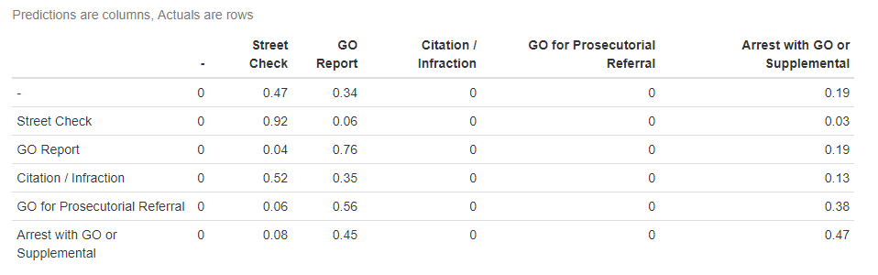
Classification Tree: Stop resolution outcome
Accuracy Results on Holdout:
92% of street checks were predicted accurately. 76% of GO Reports were predicted accurately. 47% of Arrests were predicted accurately (“Arrest with GO or Supplemental”).
Accuracy Results of the Overall Model, For Reference:
91% of street checks were predicted accurately. 77% of GO Reports were predicted accurately. 48% of Arrests were predicted accurately (“Arrest with GO or Supplemental”).
The model is stable.
Note on columns 3, and 4, in the table:
The model maintains relatively good accuracy even though it assumes (“predicts”) that neither of those two events will ever occur.
This is due to the very low incidence of these two events occurring in the actual dataset (0.1% and 2%, respectively).

Slide 39
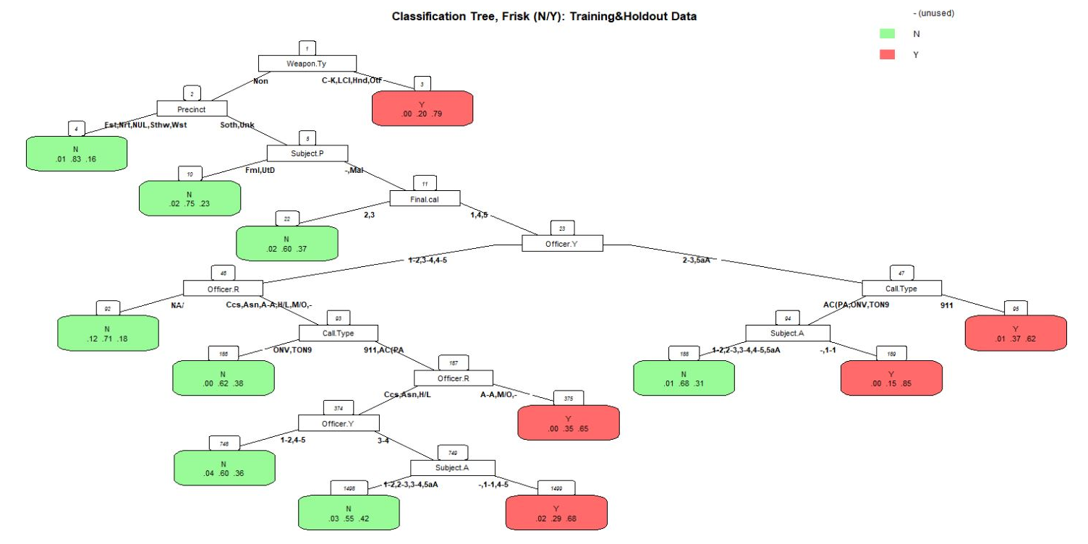
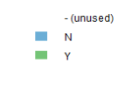
Frisks (model 1)

Slide 40
Frisks (model 1)
Officer.Race=
Native American/Alaska
Officer.Race=
African-American; Mix/Other; - (Null)
“71% chance of NO frisk”
“65% chance of frisk”

Slide 41
Frisks (model 1)
n= 26042 Legend: node), split, n, loss, yval, (yprob) * denotes terminal node Indentation level indicates level
1) root 26042 5940 N (0.014169419 0.771906920 0.213923662)
2) Weapon.Type=None 24633 4819 N (0.014776925 0.804368124 0.180854951)
4) Precinct=East,North,NULL,Southwest,West 22274 3849 N (0.014142049 0.827197630 0.158660321) *
5) Precinct=South,Unknown 2359 970 N (0.020771513 0.588808817 0.390419669)
10) Subject.Perceived.Gender=Female,Unable to Determine 525 132 N (0.020952381 0.748571429 0.230476190) *
11) Subject.Perceived.Gender=-,Male 1834 838 N (0.020719738 0.543075245 0.436205016)
22) Final.call.urgency=2,3 1012 400 N (0.023715415 0.604743083 0.371541502) *
23) Final.call.urgency=1,4,5 822 398 Y (0.017031630 0.467153285 0.515815085)
46) Officer.YOB=18 - 25,36 - 45,46 - 55 344 158 N (0.026162791 0.540697674 0.433139535)
92) Officer.Race=Native American/Alaskan 17 5 N (0.117647059 0.705882353 0.176470588) *
93) Officer.Race=Caucasian,Asian,African-American,Hispanic/Latino,Mix/Other,- 327 153 N (0.021406728 0.532110092 0.446483180)
186) Call.Type=ONVIEW,TELEPHONE OTHER, NOT 911 77 29 N (0.000000000 0.623376623 0.376623377) *
187) Call.Type=911,ALARM CALL (NOT POLICE ALARM) 250 124 N (0.028000000 0.504000000 0.468000000)
374) Officer.Race=Caucasian,Asian,Hispanic/Latino 224 107 N (0.031250000 0.522321429 0.446428571)
748) Officer.YOB=18 - 25,46 - 55 83 33 N (0.036144578 0.602409639 0.361445783) *
749) Officer.YOB=36 - 45 141 71 Y (0.028368794 0.475177305 0.496453901)
1498) Subject.Age.Group=18 - 25,26 - 35,36 - 45,56 and Above 100 45 N (0.030000000 0.550000000 0.420000000) *
1499) Subject.Age.Group=-,1 - 17,46 - 55 41 13 Y (0.024390244 0.292682927 0.682926829) *
375) Officer.Race=African-American,Mix/Other,- 26 9 Y (0.000000000 0.346153846 0.653846154) *
47) Officer.YOB=26 - 35,56 and Above 478 203 Y (0.010460251 0.414225941 0.575313808)
94) Call.Type=ALARM CALL (NOT POLICE ALARM),ONVIEW,TELEPHONE OTHER, NOT 911 91 36 N (0.010989011 0.604395604 0.384615385)
188) Subject.Age.Group=18 - 25,26 - 35,36 - 45,46 - 55,56 and Above 78 25 N (0.012820513 0.679487179 0.307692308) *
189) Subject.Age.Group=-,1 - 17 13 2 Y (0.000000000 0.153846154 0.846153846) *
95) Call.Type=911 387 147 Y (0.010335917 0.369509044 0.620155039) *
3) Weapon.Type=Club-Knuckles-Blackjack,Lethal Cutting Instrument,Handgun,Other Firearm 1409 293 Y (0.003548616 0.204400284 0.792051100) *

Slide 42
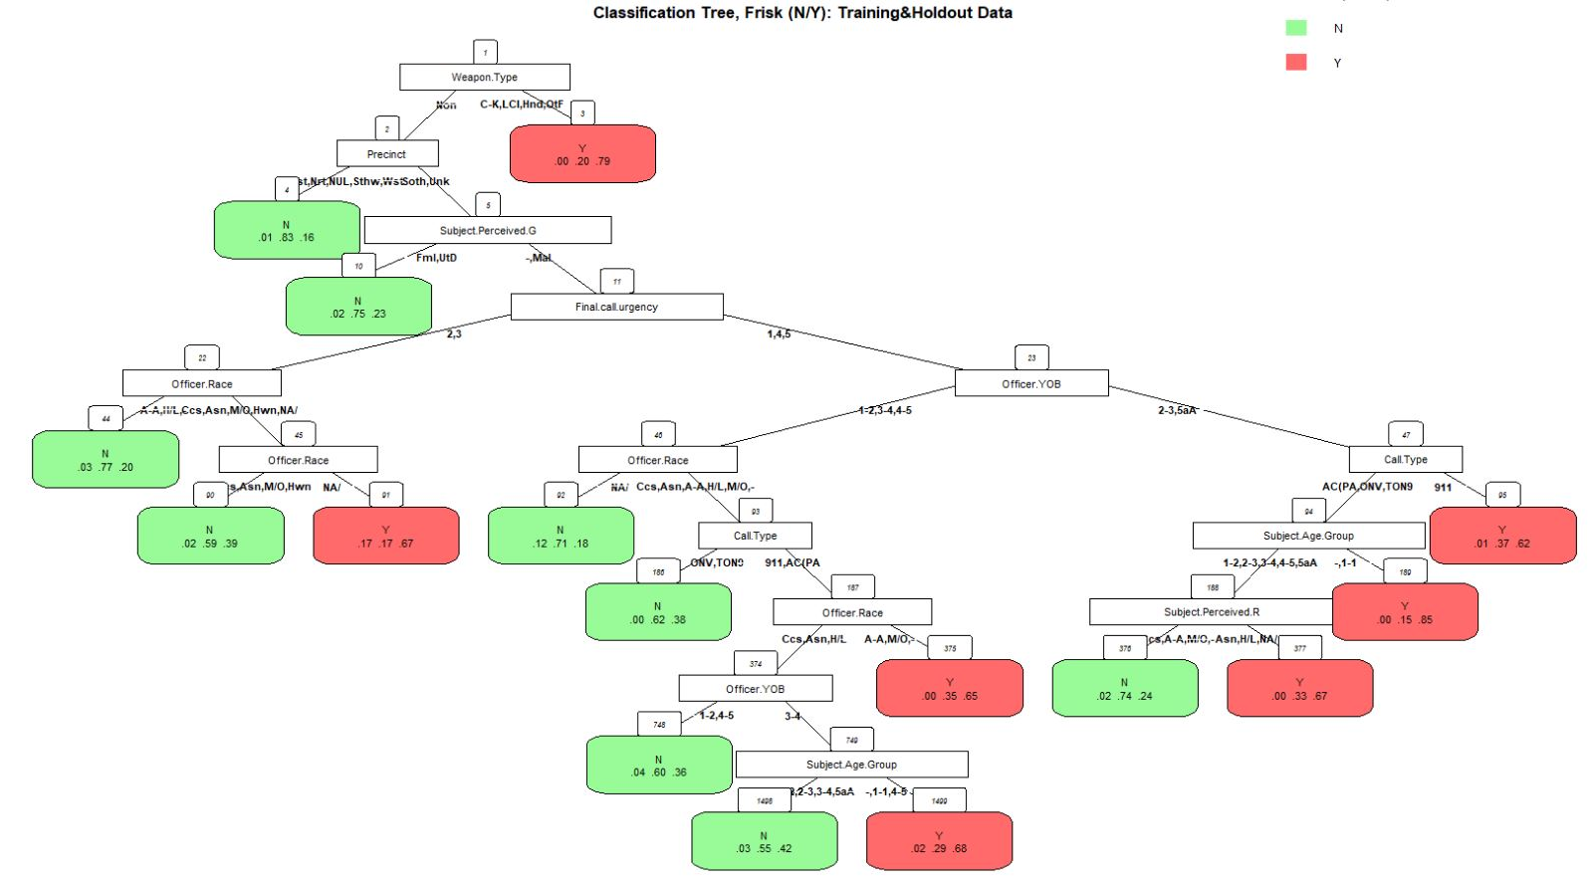
Frisks (model 11)
Allowing for greater complexity

Slide 43
Frisks (model 11)
n= 26042 Legend: node), split, n, loss, yval, (yprob) * denotes terminal node Indentation level indicates level
Allowing for greater complexity
1) root 26042 5940 N (0.014169419 0.771906920 0.213923662)
2) Weapon.Type=None 24633 4819 N (0.014776925 0.804368124 0.180854951)
4) Precinct=East,North,NULL,Southwest,West 22274 3849 N (0.014142049 0.827197630 0.158660321) *
5) Precinct=South,Unknown 2359 970 N (0.020771513 0.588808817 0.390419669)
10) Subject.Perceived.Gender=Female,Unable to Determine 525 132 N (0.020952381 0.748571429 0.230476190) *
11) Subject.Perceived.Gender=-,Male 1834 838 N (0.020719738 0.543075245 0.436205016)
22) Final.call.urgency=2,3 1012 400 N (0.023715415 0.604743083 0.371541502)
44) Officer.Race=African-American,Hispanic/Latino,- 113 26 N (0.026548673 0.769911504 0.203539823) *
45) Officer.Race=Caucasian,Asian,Mix/Other,Hawaiian,Native American/Alaskan 899 374 N (0.023359288 0.583982202 0.392658509)
90) Officer.Race=Caucasian,Asian,Mix/Other,Hawaiian 881 359 N (0.020431328 0.592508513 0.387060159) *
91) Officer.Race=Native American/Alaskan 18 6 Y (0.166666667 0.166666667 0.666666667) *
23) Final.call.urgency=1,4,5 822 398 Y (0.017031630 0.467153285 0.515815085)
46) Officer.YOB=18 - 25,36 - 45,46 - 55 344 158 N (0.026162791 0.540697674 0.433139535)
92) Officer.Race=Native American/Alaskan 17 5 N (0.117647059 0.705882353 0.176470588) *
93) Officer.Race=Caucasian,Asian,African-American,Hispanic/Latino,Mix/Other,- 327 153 N (0.021406728 0.532110092 0.446483180)
186) Call.Type=ONVIEW,TELEPHONE OTHER, NOT 911 77 29 N (0.000000000 0.623376623 0.376623377) *
187) Call.Type=911,ALARM CALL (NOT POLICE ALARM) 250 124 N (0.028000000 0.504000000 0.468000000)
374) Officer.Race=Caucasian,Asian,Hispanic/Latino 224 107 N (0.031250000 0.522321429 0.446428571)
748) Officer.YOB=18 - 25,46 - 55 83 33 N (0.036144578 0.602409639 0.361445783) *
749) Officer.YOB=36 - 45 141 71 Y (0.028368794 0.475177305 0.496453901)
1498) Subject.Age.Group=18 - 25,26 - 35,36 - 45,56 and Above 100 45 N (0.030000000 0.550000000 0.420000000) *
1499) Subject.Age.Group=-,1 - 17,46 - 55 41 13 Y (0.024390244 0.292682927 0.682926829) *
375) Officer.Race=African-American,Mix/Other,- 26 9 Y (0.000000000 0.346153846 0.653846154) *
47) Officer.YOB=26 - 35,56 and Above 478 203 Y (0.010460251 0.414225941 0.575313808)
94) Call.Type=ALARM CALL (NOT POLICE ALARM),ONVIEW,TELEPHONE OTHER, NOT 911 91 36 N (0.010989011 0.604395604 0.384615385)
188) Subject.Age.Group=18 - 25,26 - 35,36 - 45,46 - 55,56 and Above 78 25 N (0.012820513 0.679487179 0.307692308)
376) Subject.Perceived.Race=Caucasian,African-American,Mix/Other,- 66 17 N (0.015151515 0.742424242 0.242424242) *
377) Subject.Perceived.Race=Asian,Hispanic/Latino,Native American/Alaskan 12 4 Y (0.000000000 0.333333333 0.666666667) *
189) Subject.Age.Group=-,1 - 17 13 2 Y (0.000000000 0.153846154 0.846153846) *
95) Call.Type=911 387 147 Y (0.010335917 0.369509044 0.620155039) *
3) Weapon.Type=Club-Knuckles-Blackjack,Lethal Cutting Instrument,Handgun,Other Firearm 1409 293 Y (0.003548616 0.204400284 0.792051100) *

Slide 44
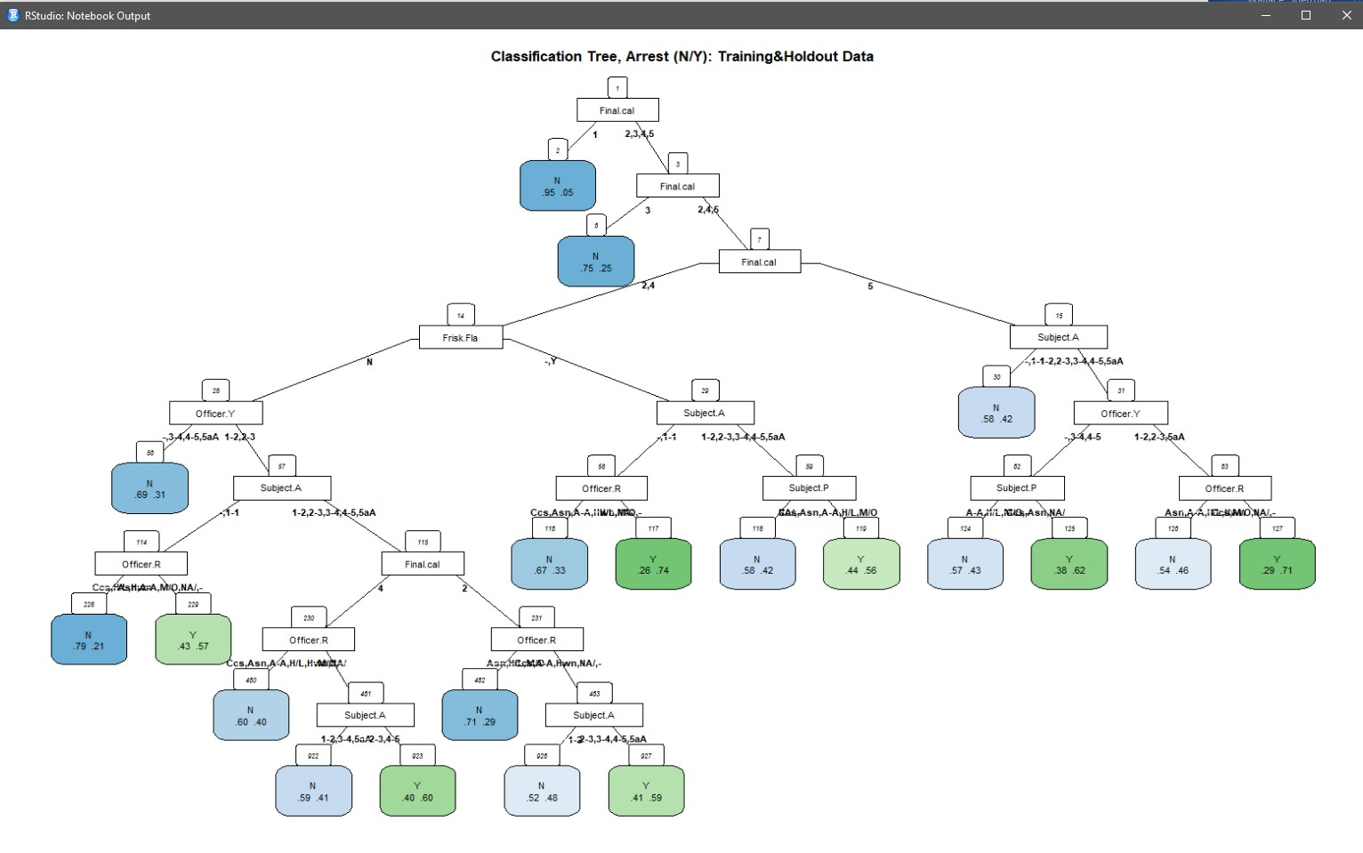
Arrests
Darker shading indicates greater odds of the outcome

Slide 45
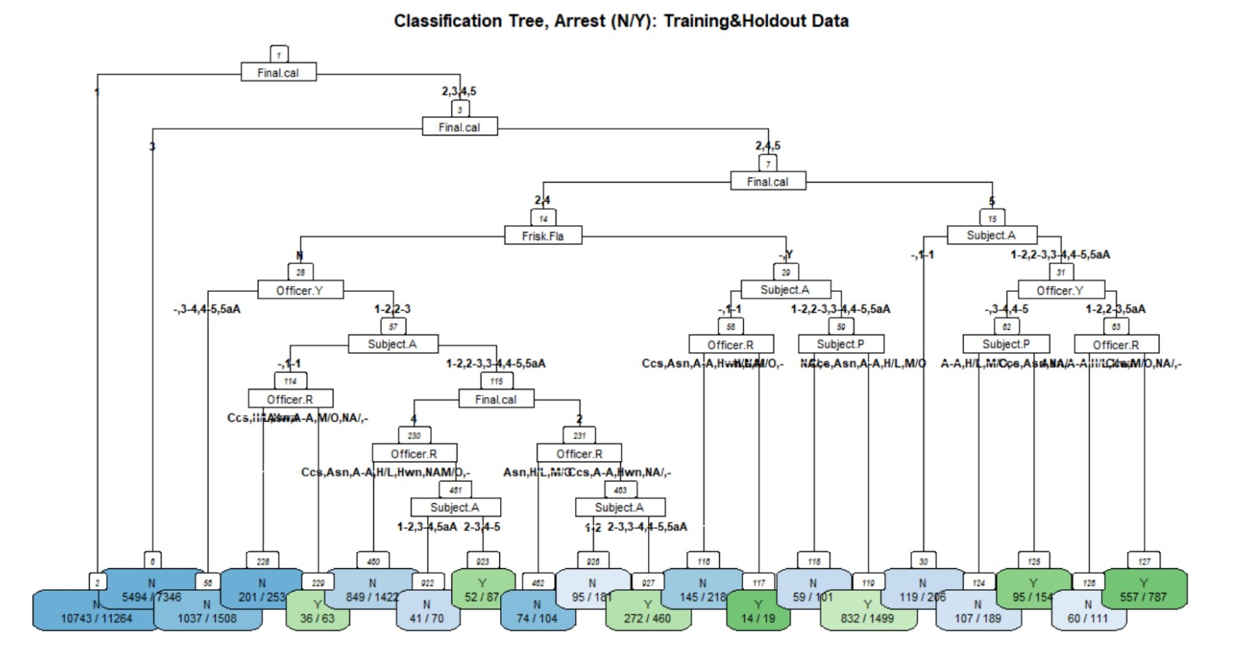
Arrests
Darker shading indicates greater odds of the outcome

Slide 46
Arrests
n= 26042 Legend: node), split, n, loss, yval, (yprob) * denotes terminal node Indentation level indicates level
1) root 26042 5807 N (0.77701405 0.22298595)
2) Final.call.urgency=1 11264 521 N (0.95374645 0.04625355) *
3) Final.call.urgency=2,3,4,5 14778 5286 N (0.64230613 0.35769387)
6) Final.call.urgency=3 7346 1852 N (0.74789001 0.25210999) *
7) Final.call.urgency=2,4,5 7432 3434 N (0.53794403 0.46205597)
14) Final.call.urgency=2,4 5985 2562 N (0.57192982 0.42807018)
28) Frisk.Flag=N 4148 1601 N (0.61403086 0.38596914)
56) Officer.YOB=-,36 - 45,46 - 55,56 and Above 1508 471 N (0.68766578 0.31233422) *
57) Officer.YOB=18 - 25,26 - 35 2640 1130 N (0.57196970 0.42803030)
114) Subject.Age.Group=-,1 - 17 316 88 N (0.72151899 0.27848101)
228) Officer.Race=Caucasian,Hispanic/Latino,Hawaiian 253 52 N (0.79446640 0.20553360) *
229) Officer.Race=Asian,African-American,Mix/Other,Native American/Alaskan,- 63 27 Y (0.42857143 0.57142857) *
115) Subject.Age.Group=18 - 25,26 - 35,36 - 45,46 - 55,56 and Above 2324 1042 N (0.55163511 0.44836489)
230) Final.call.urgency=4 1579 654 N (0.58581381 0.41418619)
460) Officer.Race=Caucasian,Asian,African-American,Hispanic/Latino,Hawaiian,Native American/Alaskan 1422 573 N (0.59704641 0.40295359) *
461) Officer.Race=Mix/Other,- 157 76 Y (0.48407643 0.51592357)
922) Subject.Age.Group=18 - 25,36 - 45,56 and Above 70 29 N (0.58571429 0.41428571) *
923) Subject.Age.Group=26 - 35,46 - 55 87 35 Y (0.40229885 0.59770115) *
231) Final.call.urgency=2 745 357 Y (0.47919463 0.52080537)
462) Officer.Race=Asian,Hispanic/Latino,Mix/Other 104 30 N (0.71153846 0.28846154) *
463) Officer.Race=Caucasian,African-American,Hawaiian,Native American/Alaskan,- 641 283 Y (0.44149766 0.55850234)
926) Subject.Age.Group=18 - 25 181 86 N (0.52486188 0.47513812) *
927) Subject.Age.Group=26 - 35,36 - 45,46 - 55,56 and Above 460 188 Y (0.40869565 0.59130435) *
29) Frisk.Flag=-,Y 1837 876 Y (0.47686445 0.52313555)
58) Subject.Age.Group=-,1 - 17 237 87 N (0.63291139 0.36708861)
116) Officer.Race=Caucasian,Asian,African-American,Hawaiian,Native American/Alaskan 218 73 N (0.66513761 0.33486239) *
117) Officer.Race=Hispanic/Latino,Mix/Other,- 19 5 Y (0.26315789 0.73684211) *
59) Subject.Age.Group=18 - 25,26 - 35,36 - 45,46 - 55,56 and Above 1600 726 Y (0.45375000 0.54625000)
118) Subject.Perceived.Race=Native American/Alaskan,- 101 42 N (0.58415842 0.41584158) *
119) Subject.Perceived.Race=Caucasian,Asian,African-American,Hispanic/Latino,Mix/Other 1499 667 Y (0.44496331 0.55503669) *
15) Final.call.urgency=5 1447 575 Y (0.39737388 0.60262612)
30) Subject.Age.Group=-,1 - 17 206 87 N (0.57766990 0.42233010) *
31) Subject.Age.Group=18 - 25,26 - 35,36 - 45,46 - 55,56 and Above 1241 456 Y (0.36744561 0.63255439)
62) Officer.YOB=-,36 - 45,46 - 55 343 166 Y (0.48396501 0.51603499)
124) Subject.Perceived.Race=African-American,Hispanic/Latino,Mix/Other,- 189 82 N (0.56613757 0.43386243) *
125) Subject.Perceived.Race=Caucasian,Asian,Native American/Alaskan 154 59 Y (0.38311688 0.61688312) *
63) Officer.YOB=18 - 25,26 - 35,56 and Above 898 290 Y (0.32293987 0.67706013)
126) Officer.Race=Asian,African-American,Hispanic/Latino,Hawaiian 111 51 N (0.54054054 0.45945946) *
127) Officer.Race=Caucasian,Mix/Other,Native American/Alaskan,- 787 230 Y (0.29224905 0.70775095) *

Slide 47
Classification Tree: Stop resolution outcomes 2
A simplified model with fewer variables to consider:
Variables Used:
Stop.Resolution ← dependent variable
Final.call.severity
Subject.Age.Group
Subject.Perceived.Race
Officer.YOB
Officer.Race
Precinct
Possible Resolution Outcomes: (Stop.Resolution)
- | 1%
Street Check | 37%
GO Report | 37%
Citation / Infraction | 0%
GO for Prosecutorial Referral | 2%
Arrest with GO or Supplemental | 22%
Total | 100%
(Ranked by severity)

Slide 48
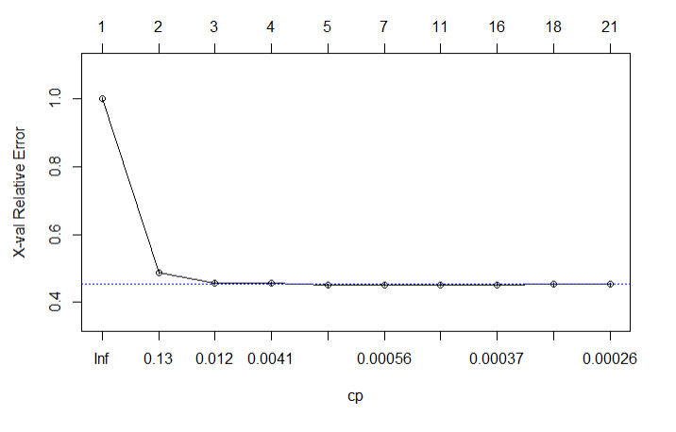
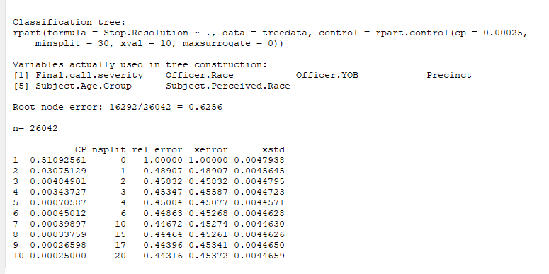
Stop Resolution Outcome 11
Dependent: Stop.Resolution
Independents: Final.call.severity; Subject.Age.Group; Subject.Perceived.Race; Officer.YOB; Officer.Race; Precinct
What this shows is that after the 3rd split, almost ZERO incremental gain in explanatory power is gained by additional nsplits.
This indicates that the lower branches add very little additional accuracy or goodness of fit that hasn't already been decided by the upper branches.
Accuracy rates with only 3 nsplits:
- 91% of street checks predicted accurately.
- 79% of GO Reports predicted accurately.
- 37% of Arrests predicted accurately.
Accuracy rates with 20 nsplits:
- 91%, 85%, 30%, respectively.

Slide 49
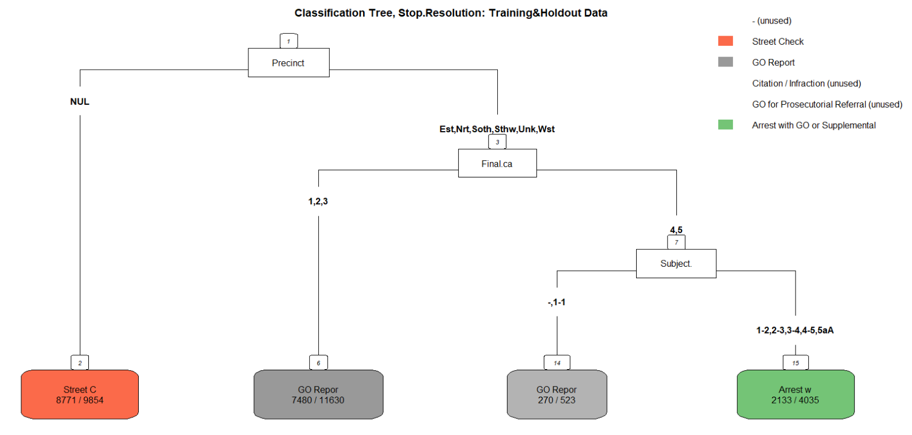
Stop Resolution Outcome 11
Dependent: Stop.Resolution
Independents: Final.call.severity; Subject.Age.Group; Subject.Perceived.Race; Officer.YOB; Officer.Race; Precinct
Final.call.sev
Subject.Age
- , 1-17
18 - 25,26 - 35,36 - 45,46 - 55,56 and Above

Slide 50
Sources Utilized:
Dataset:
Seattle Terry Stops - https://www.kaggle.com/city-of-seattle/seattle-terry-stops
Data provided by Seattle Police Department
_____________________________________________
Stops and Detentions Annual Report 2017
- http://spdblotter.seattle.gov/wp-content/uploads/2017/05/Stops-and-Detentions-Annual-Report-Final.pdf
Demographics of Seattle - https://en.wikipedia.org/wiki/Demographics_of_SeattleSss

